Slide 1



Slide 2

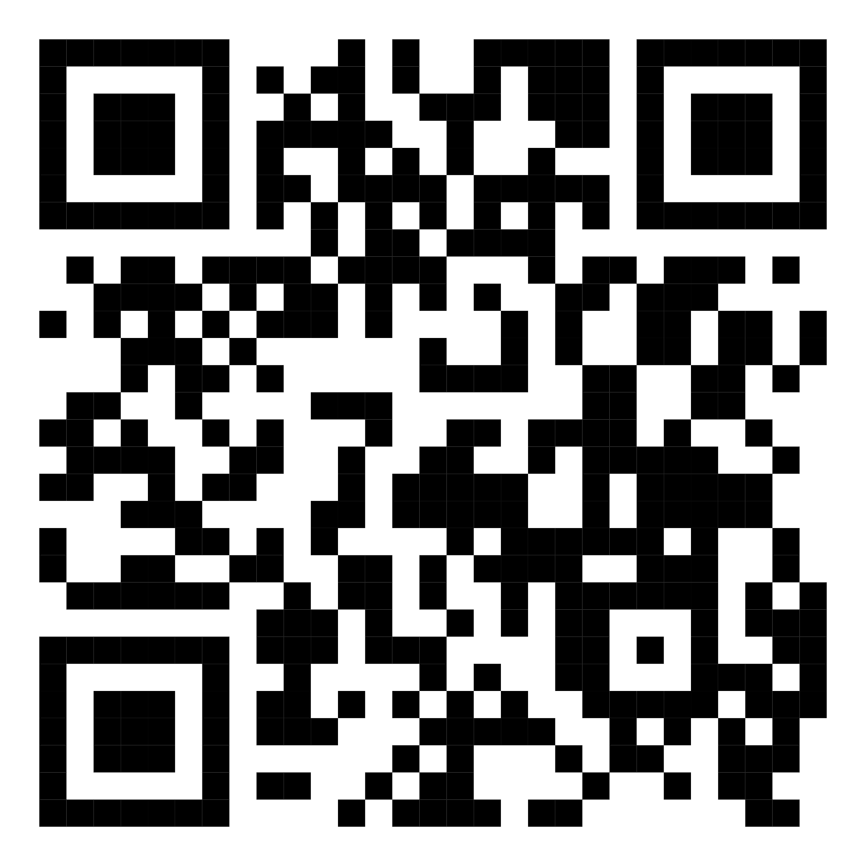
HACKTOBERFEST 2023
MLH PAGE REGISTRATION

Slide 3

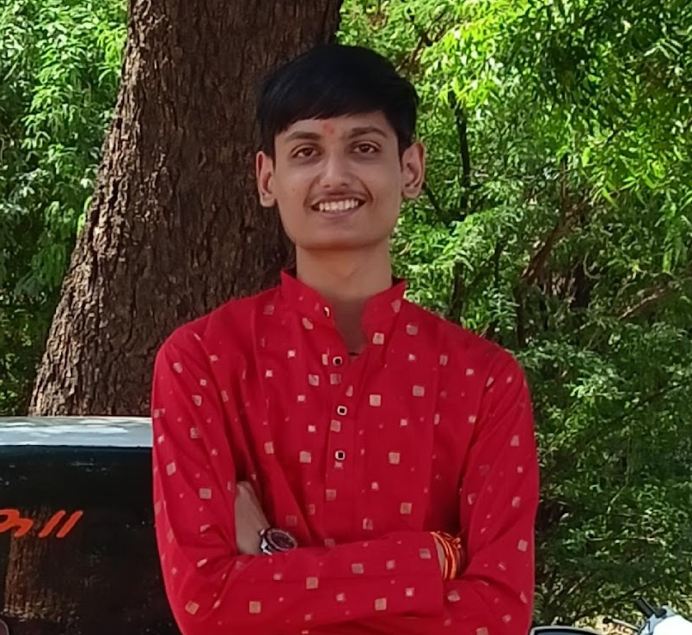



HACKTOBERFEST 2023 / SPEAKER
GUNJ JOSHI
Core Team, Cyber security Club

Slide 4



AGENDA
Recap : Steps to make a contribution for Hacktoberfest
01
First contribution – Community Space
02
Contributing for Ecocrypt project and the website of CSY Club
03

Slide 5


HACKTOBERFEST 2023
STEPS FOR OPEN SOURCE CONTRIBUTION
01.
02.
Find a project
Fork the repository
03.
04.
Clone the repository
Create a new branch

Slide 6
HACKTOBERFEST 2023
STEPS FOR OPEN SOURCE CONTRIBUTION
05.
06.
Make changes
Push changes
07.
08.
Create a pull request
Review and discuss

Slide 7


Ready.Set.Go!

Slide 8
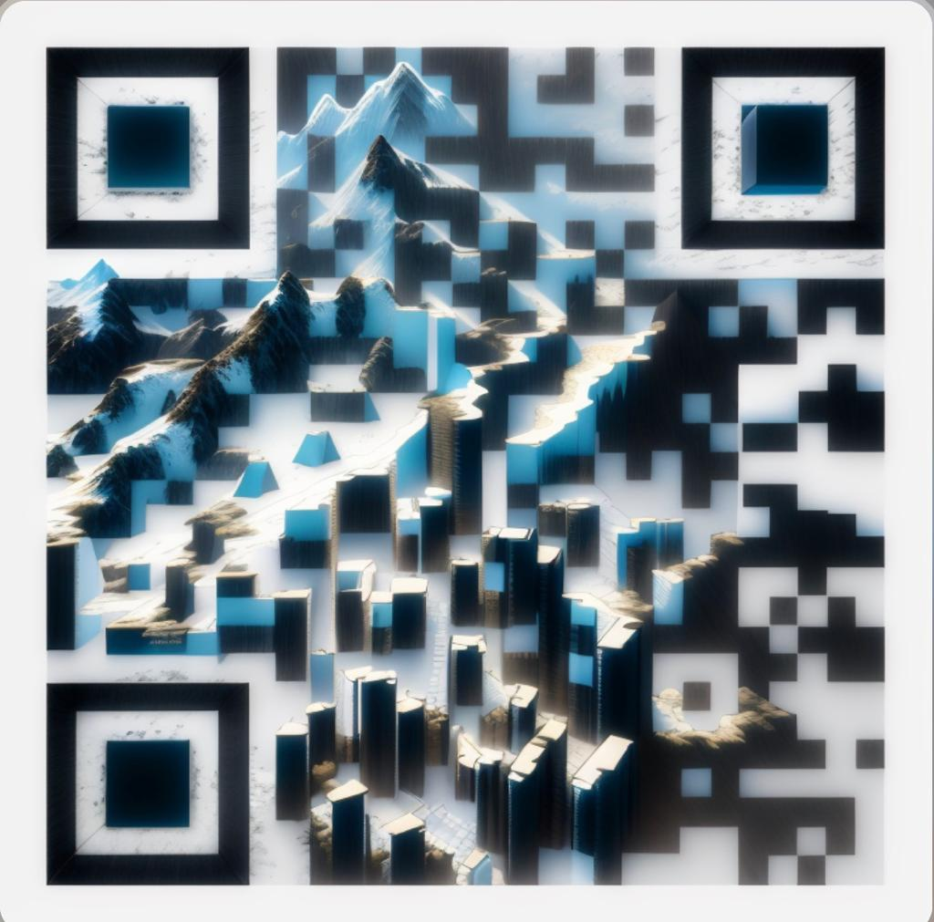
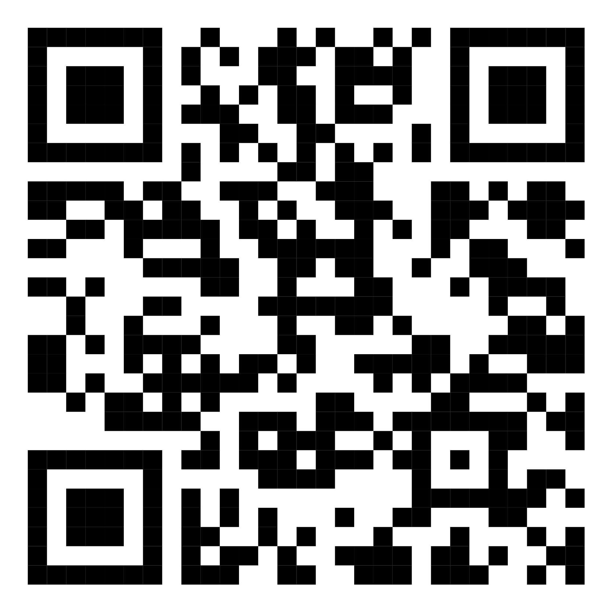
LINKTREE
FEEDBACK

